Slide 1
Chapter 4
SOFTWARE DESIGN, ARCHITECTURE AND PRINCIPLES
Total Hour:7hrs
Presented by
Er.Harendra Bikram Shah
Lecturer
Department of Computer Engineering
NAST

Slide 2
OUTLINES
4.1 Design Modeling Principles
4.2 Design Process
4.3 Architectural design
4.3.1 Layered
4.3.2 Repository
4.3.3 Client Server
4.3.4 Pipe and Filter
4.4 Interface, Component, Database Design
4.5 Design Patterns
4.6 Security by Design
4.7 Object Oriented Design
4.8 Embedded System Design

Slide 3
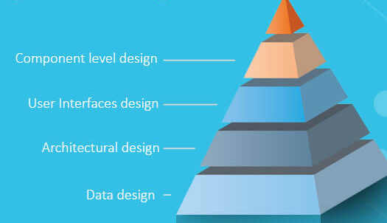
Design Modeling Principles
It represents the features of the software that helps engineer to develop it effectively
Different methods like data-driven, pattern-driven, or object-oriented methods are used for constructing the design model.
All these methods use set of design principles for designing a model.

Slide 4
Design Modeling Principles
Design must be traceable to the analysis model:
Always consider architecture of the system to be built:
Focus on the design of the data:
User interfaces should consider the user first:
Components should be loosely coupled:
Interfaces both user and internal must be designed:
Component level design should exhibit Functional independence:

Slide 5
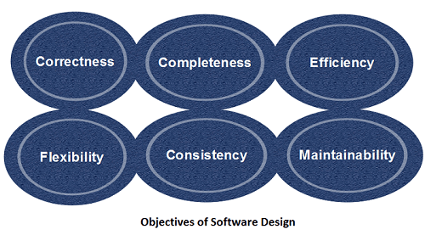
DESIGN PROCESS
mechanism to transform user requirements into some suitable form, which helps the programmer in software coding and implementation.
It deals with representing the client's requirement, as described in SRS (Software Requirement Specification) document, into a form, i.e., easily implementable using programming language.

Slide 6
DESIGN PROCESS
The software design process can be divided into the following three levels or phases of design:
Interface Design: specification of the interaction between a system and its environment.
Architectural Design: specification of the major components of a system, their responsibilities, properties, interfaces, and the relationships and interactions between them
Detailed Design: specification of the internal elements of all major system components, their properties, relationships, processing, and often their algorithms and the data structures

Slide 7
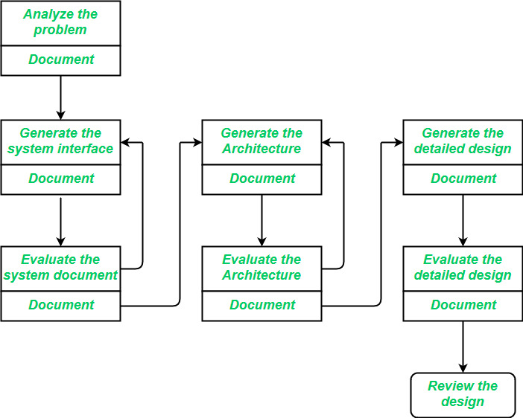
SOFTWARE DESIGN PROCESS

Slide 8
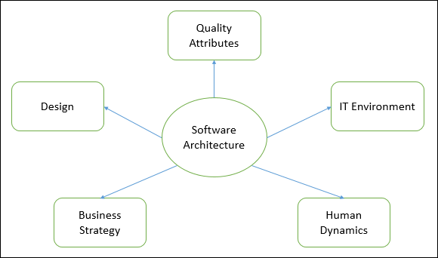
ARCHITECTURAL DESIGN
"The process of defining a collection of hardware and software components and their interfaces to establish the framework for the development of a computer system" is how the IEEE defines architectural design.
Components of Architectural Design:
System Organization:
Abstraction and Decomposition:
Design Patterns:
Architectural Styles:
Data Management:
Interaction and Communication:
Scalability:
Security:
Optimization and performance:
Concerns with Cross-Cutting:
Extensibility and Flexibility:
Communication and Documentation:
Validation and Testing:
Maintainability:
Cost factors to consider:

Slide 9
ARCHITECTURAL DESIGN
Properties of Architectural Design:
Modularity:
Scalability:
Maintainability:
Flexibility:
Reliability:
Security:
Documentation:
Advantages of Architectural Design
Structure and Clarity:
Modularity:
Scalability:
Maintenance and Expandability:
Performance Optimization:
Security:
Reliability:
Interoperability:
Disadvantages of Architectural Design
Initial Time Investment:
Over-Engineering:
Rigidity:
Complexity:
Misalignment with Requirements:
Resistance to Change:
Communication Challenges:
Resource Intensive:

Slide 10
TYPES OF ARCHITECTURAL DESIGN PATTERNS
1. Layered Architecture Pattern
2. Client-Server Architecture Pattern
3. Event-Driven Architecture Pattern
4. Microkernel Architecture Pattern
5. Microservices Architecture Pattern
6. Space-Based Architecture Pattern
7. Master-Slave Architecture Pattern
8. Pipe-Filter Architecture Pattern
9. Broker Architecture Pattern
10. Peer-to-Peer Architecture Pattern

Slide 11
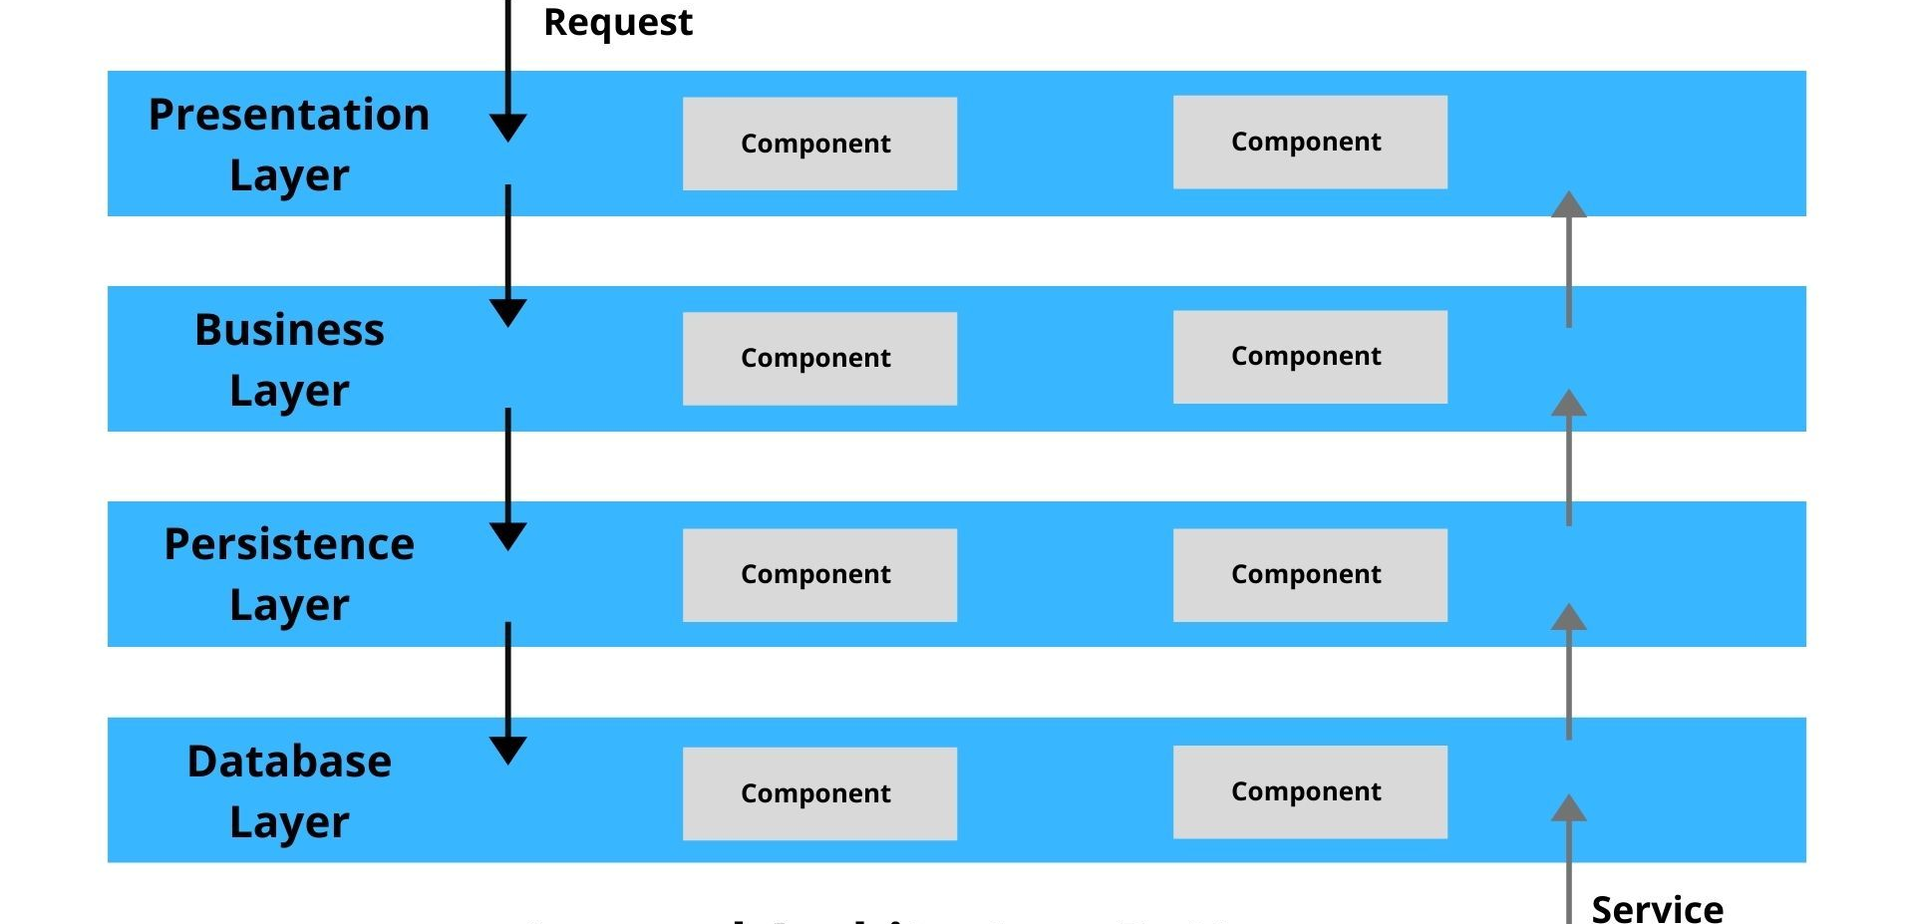
TYPES OF ARCHITECTURAL DESIGN PATTERNS
1. Layered Architecture Pattern
Advantages:
Scalability:
Flexibility:
Maintainability:
Disadvantages:
Complexity: .
Performance Overhead:
Strict Layer Separation:
Use Cases:
Enterprise Applications like Customer Relationship Management (CRM).
Web Applications like E-commerce platforms.
Desktop Applications such as Financial Software.
Mobile Applications like Banking applications.
Content Management Systems like WordPress

Slide 12
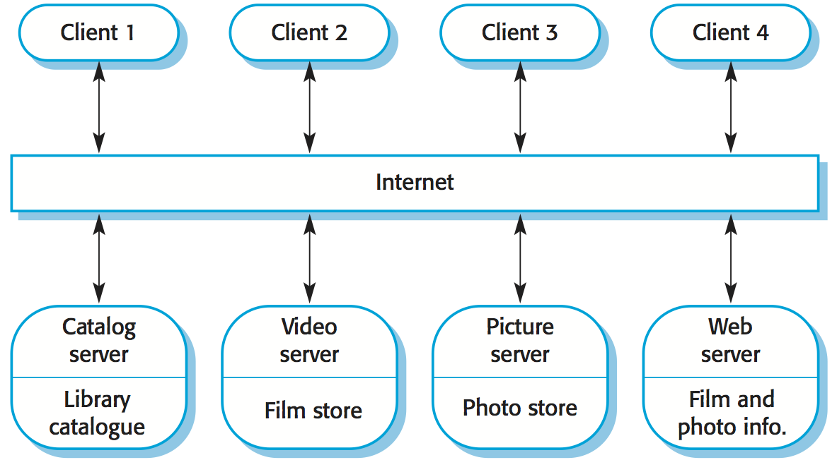
Client-Server Architecture Pattern
Advantages:
Centralized Management:
Scalability:
Security:
Disadvantages:
Single Point of Failure:
Costly:
Complexity:
Use Cases:
Web Applications like Amazon.
Email Services like Gmail, Outlook.
File Sharing Services like Dropbox, Google Drive.
Media Streaming Services like Netflix.
Education Platforms like Moodle.

Slide 13
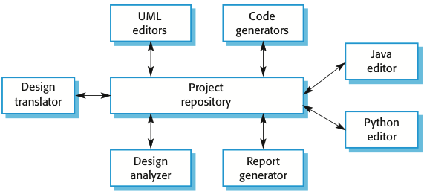
Repository Architecture Pattern
Benefits of Repository Architecture:
Improved Testability:
Flexibility and Scalability:
Centralized Query Management
Disadvantages of Repository Architecture Pattern
Increased Complexity:
Performance Overheads:
Redundant Code
Use Cases of Repository Architecture Pattern
Enterprise Applications:
Applications with Multiple Data Sources:

Slide 14

Pipe Filter Architecture Pattern
structures a system around a series of processing elements called filters that are connected by pipes.
Each filter processes data and passes it to the next filter via pipe.
Advantages:
Reusability:
Scalability:
Parallelism:
Disadvantages:
Debugging Difficulty:
Data Format constraints:
Latency:
Use Cases:
Data Processing Pipelines like Extract, Transform, Load (ETL) processes in data warehousing.
Compilers.
Stream-Processing like Apache Flink.
Image and Signal Processing.

Slide 15
Choosing the Right Architecture
Here are some key considerations to help choose the right architecture pattern:
Scalability: How well the system need to scale with the increasing load?
Performance: Are there any specific performance requirements such as low latency?
Availability: Does the system need to be fault-tolerant?
Security: What are the security requirements of the system and what are the potential threats?
Budget: What are the budget constraints for the development and the maintenance of the system?
Tools and Technology Stack: What technology and tools will be required?

Slide 16
Interface, Component, Database Design
Interface Design:
It is a crucial aspect of software engineering that focuses on the interaction between a user and a system.
Key Principles of Interface Design
User-Centered Design:
Consistency and Standardization:
Clarity and Simplicity:
Accessibility:
Feedback and Error Handling:
Steps in Interface Design
Identify Interface Users
Define Functional Requirements
Choose Communication Protocols and Data Formats
Design the Interface Structure
Create Documentation
Implement and Test

Slide 17
Interface, Component, Database Design
Types of Interfaces:
Graphical User Interface (GUI):
Command-Line Interface (CLI):
Tools for Interface Design:
Design Tools: Figma, Adobe XD, Sketch
Prototyping Tools: InVision, ProtoPie
User Testing Tools: UserTesting, Lookback
Best Practices for Interface Design
Know Your User:
Prioritize Clarity and Simplicity:
Test Early and Often:
Iterate and Refine:
Accessibility:

Slide 18
Interface, Component, Database Design
Component Based Design:
It is all about taking complex software systems and making them into small, reusable pieces or simply modules.
Importance of Component-Based Design in Software Development
It improves modularity
Component-based design is so important for maintainability
When it comes to scalability, component-based design forms another vital benefit.
Breaking down elements and establishing logical interfaces facilitate the creation of a modular system
Characteristics of Component-Based Design
Below are the characteristics of component-based design:
Modularity:
Reusability:
Interoperability:
Encapsulation:
Scalability:

Slide 19
Interface, Component, Database Design
Types of Components
UI Components
Service Components
Data Components
Infrastructure Components
Integration Components
Reusable Components
Principles of Component Design
Below are some important principles of component design:
Single Responsibility Principle (SRP):
Open/Closed Principle (OCP):
Interface Segregation Principle (ISP):
Dependency Inversion Principle (DIP):
Separation of Concerns (SoC):

Slide 20
Tools and Technologies for Component Design
Component Frameworks:
Dependency Injection Containers:
Middleware Platforms:
Component Repositories:
Component Testing Tools:
Challenges of Component Design
Granularity:
Interoperability:
Dependency Management:
Performance Overhead:
Real world Examples of Component Design
E-commerce Platforms:
Content Management Systems (CMS):
Enterprise Resource Planning (ERP) Systems:

Slide 21
DATABASE DESIGN
Database design is the process of organizing data in a database to optimize its efficiency and usability.
Key Concepts in Database Design
Data Modeling:
Normalization:
Data Integrity:
Data Security:
Database Design Process
Requirements Gathering:
Conceptual Data Modeling:
Logical Data Modeling:
Physical Data Modeling:
Implementation:
Testing:
Deployment:

Slide 22
Database Design Tools
ER Diagram Tools: Draw.io, Lucidchart, Microsoft Visio
Database Design Tools: SQL Server Management Studio, Oracle SQL Developer, MySQL Workbench
Best Practices for Database Design
Keep it Simple:
Normalize Data:
Index Wisely:
Optimize Queries:
Consider Performance:
Security:
Regular Backup:

Slide 23
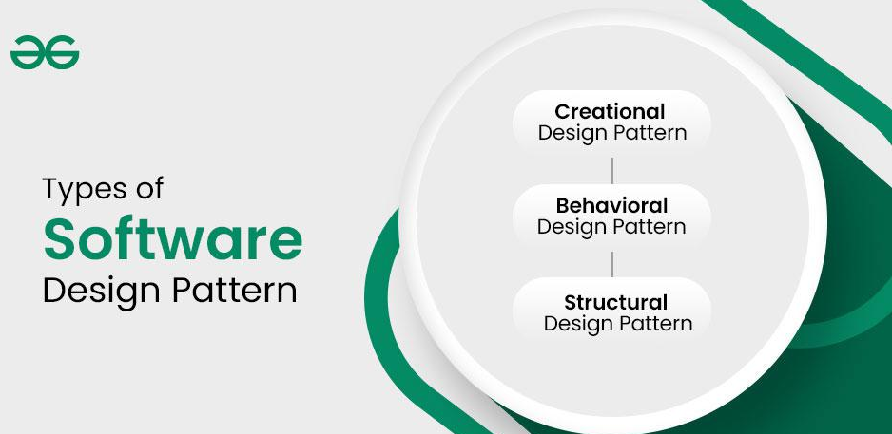
Design Pattern

Slide 24
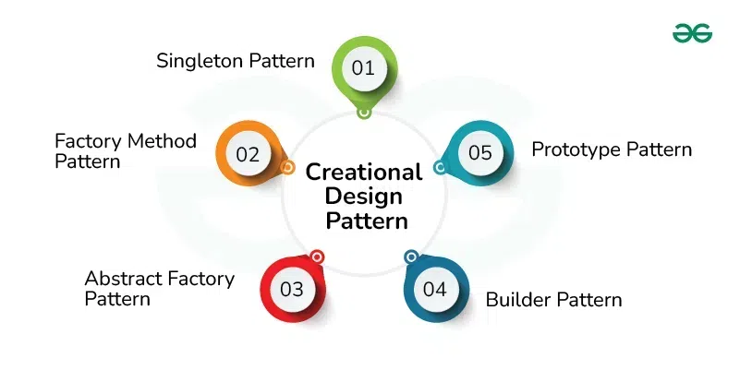
Creational Design Pattern

Slide 25
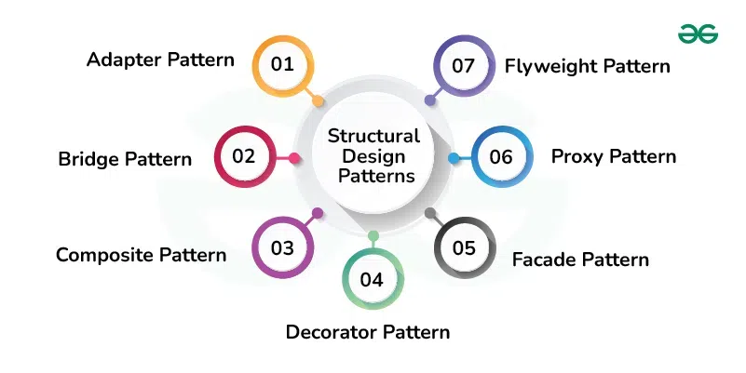
Structural Design Pattern

Slide 26
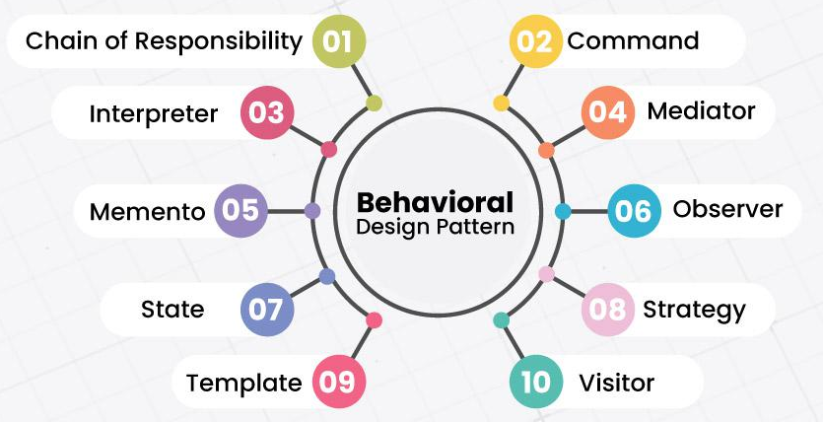
Behavioral Design Pattern

Slide 27
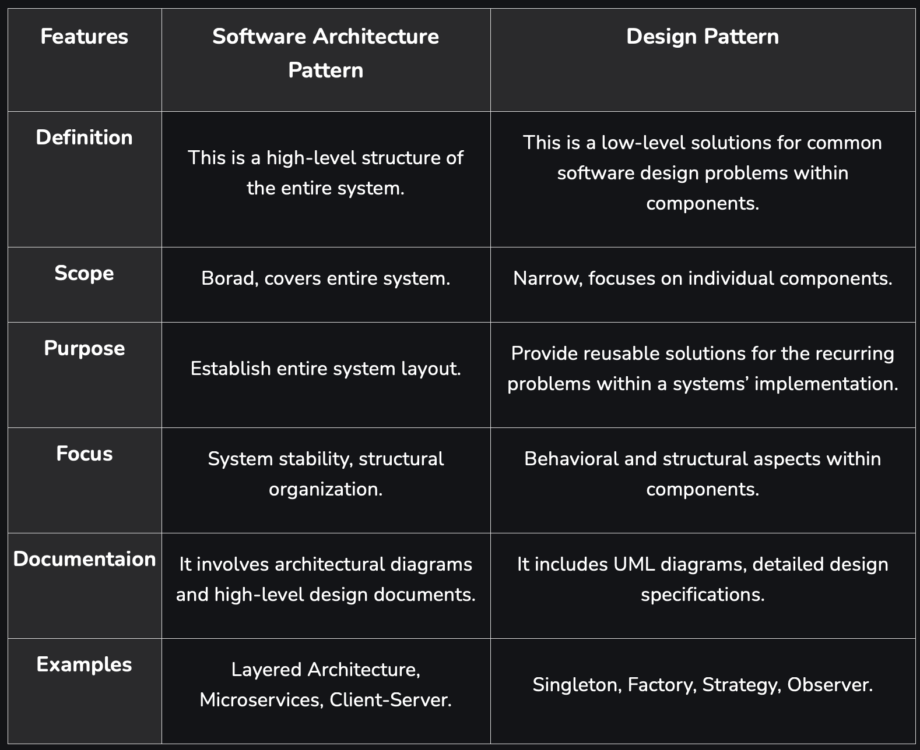
Architectural Patterns Vs Design Patterns

Slide 28
Security by Design
It is a software engineering approach that incorporates security considerations into every stage of the development lifecycle.
Core Principles of Security by Design
Principle of Least Privilege
Defense in Depth
Secure by Default
Separation of Duties
Fail Securely
Economy of Mechanism
Complete Mediation
Open Design
Privacy by Design
Continuous Monitoring and Logging

Slide 29
Security by Design
Implementing Security by Design in the Development Lifecycle
Requirements Gathering
Threat Modeling
Secure Architecture Design
Code Review and Static Analysis
Automated Testing for Security
Data Security
Configuration and Deployment
Access Control and Authentication
Logging and Monitoring
Incident Response and Recovery
Benefits of Security by Design
Reduced Vulnerabilities and Risks
Cost Savings
Regulatory Compliance
Increased Trust
Improved System Resilience
Example of Security by Design (Web Application)
Authentication:
Data Encryption:
API Security:
Input Validation:
Logging and Monitoring:

Slide 30
Embedded System Design
Embedded System Design:
Embedded System Design in Software Engineering focuses on creating specialized computing systems that are tightly
Key Aspects of Embedded System Design in Software Engineering
Requirement Analysis and Specification
System Architecture Design
Software Design
Hardware and Software Integration
Communication Protocols
Testing and Validation
Optimization for Resources
Deployment and Maintenance
Software Engineering Techniques in Embedded System Design:
Model-Based Development
Agile and Iterative Development
Static Code Analysis and Code Review
Simulation and Emulation
Debugging and Diagnostics

Slide 31
Embedded System Design
Applications of Embedded System Design
Automotive Systems:
Industrial Automation:
Medical Devices:
Consumer Electronics:
Challenges in Embedded System Design
Real-Time Constraints:
Power Efficiency:
Reliability and Safety:
Security:

Slide 32
End of the Unit

Slide 33
THANK YOU

